Slide 1
OBJECT ORIENTED
ANALYSIS AND DESIGN
Ch - 9
Relationships
A study material for the students of GLS University

Slide 2
What is a relationship?
A meaningful connection between UML elements
Shows how different parts of a system are connected
Between actors and use cases → Association
Example: Customer → places order → Order Use Case
Between use cases →
Generalization (one use case is a specialized form of another)
«include» (common behavior reused by other use cases)
«extend» (optional or conditional behavior)
Between actors → Generalization
Example: Admin is a specialized version of User
Between objects → Links
A link connects two objects that can communicate.
Between classes → Associations
Show how objects of one class are connected to objects of another.

Slide 3
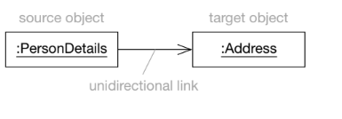
What is a Link?
• A link is a connection between two objects
• Allows objects to send messages to each other
Implementation:
Java → object reference
C++ → pointer or reference
Types of Links:
- Unidirectional (one-way) - one-way arrow shows which object can access the other.
- Bidirectional (two-way) - no arrows; both can access each other.

Slide 4
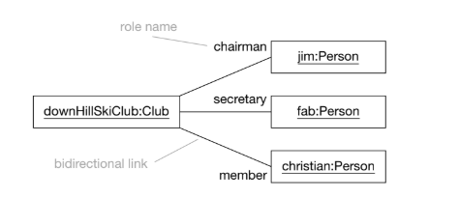
Object Diagrams
Object diagrams show objects and links at a specific time.
Links are dynamic – they can change during program execution.
Example -

Slide 5
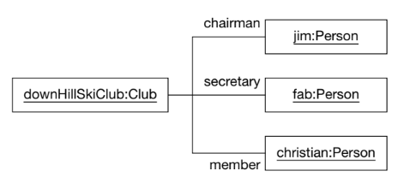
Paths in Diagrams
Paths = lines connecting elements in UML diagrams
Styles:
Orthogonal → straight horizontal/vertical lines
Oblique → slanted lines
Rule: diagrams should always be neat and clear

Slide 6
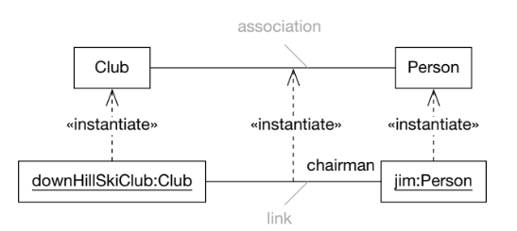
What is an association?
Associations are relationships between classes
Links connect objects; associations connect classes
A link = instantiation of an association
Objects ↔ Classes | Links ↔ Associations

Slide 7
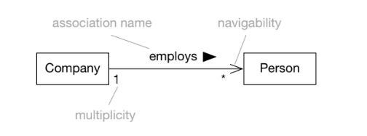
Association Syntax
Can include association name, role names, multiplicity, navigability
Example: A Company employs many Persons

Slide 8
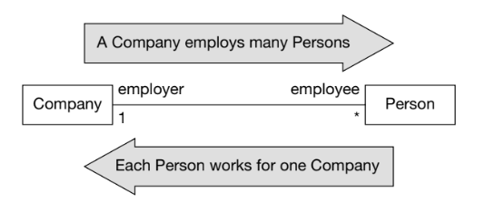
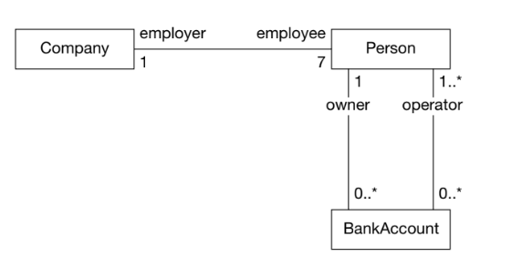
Multiplicity
Defines how many objects can participate in a relationship
0..1 → Zero or one
1 → Exactly one
0..* or * → Zero or many
1..* → One or many

Slide 9
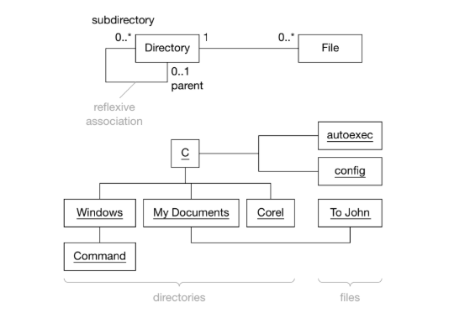
Reflexive Associations
Class linked to itself
Example: Directory has subdirectories (0..*)
Each Directory may have one parent (0..1)

Slide 10
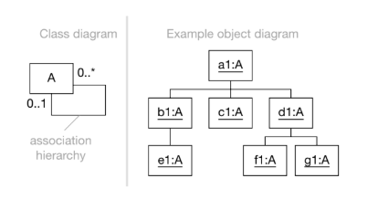
Hierarchies vs Networks
Hierarchy: one root, rigid structure (e.g., directory tree)
Network: no fixed root, flexible connections (e.g., WWW)

Slide 11
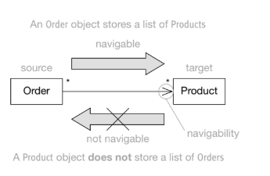
Navigability
Defines direction of message passing
Example: Order → Product (Order knows Products)
Product ✘ Order (Product doesn’t know Orders)
Helps minimize coupling

Slide 12
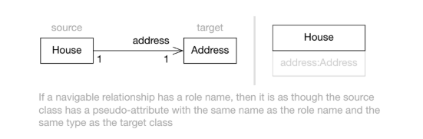
Associations & Attributes
Association ≈ pseudo-attribute
Example: House has address:Address
Multiplicity > 1 → usually model as association
Multiplicity = 1 → may be modeled as attribute

Slide 13
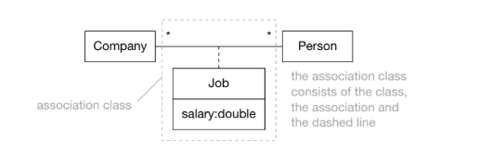
Association Classes
Used in many-to-many with extra attributes
Example: Person ↔ Company with Job (salary)
If multiple jobs possible → reify as normal class

Slide 14
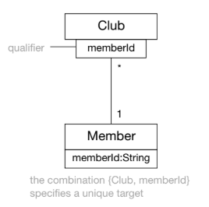
Qualified Associations
Narrow a many-to-many into many-to-one using unique key
Example: Club → Member (qualified by memberId)

Slide 15
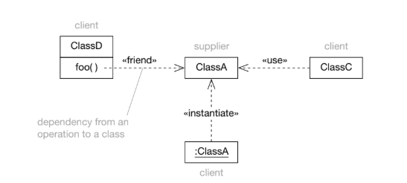
What is a Dependency?
Relationship where client depends on supplier
Change in supplier may affect client
Not always association (e.g., passing objects as parameters)

Slide 16
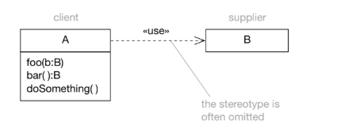
Common Usage Dependency
«use»: client class uses supplier class
Example: A method in Class A creates or returns an object of Class B

Slide 17
THANK YOU

